Slide 1


Quick Guide to Comprehensive Planning
"This project has been funded in part by the Climate Smart Communities Grant Program, Title 15 of the
Environmental Protection Fund through the New York State Department of Environmental Conservation."

Slide 2

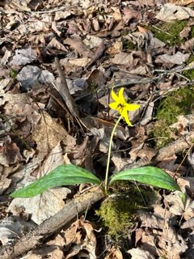







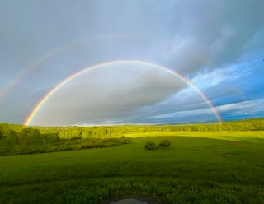

Comprehensive Planning
First Steps
Assemble Steering Committee
Consider who will comprise the core group overseeing the process. Members should be prepared to attend meetings consistently, and the committee should be as representative as possible. It can include town officials, business owners, and other prominent and trusted community members.
1
Organize Subcommittees
In addition to the steering committee, plans typically rely on several smaller groups focused on specific subject areas (e.g. housing, transportation, infrastructure, etc.) Members should have knowledge relevant to the subcommittee.
2
We’re Here!
Survey Logistics
The cost of collecting survey data depends on many factors, including how the survey is designed, distributed, collected, and analyzed. Establishing whether responses will be collected online, by mail, or both, what kinds of questions will be posed, and what information you hope to glean will all save time in the long run.
3
Review Other Local Plans
Plans can range widely in terms of content and complexity. Reviewing plans from nearby communities and keeping a list of topics you hope to cover will provide context as well as ideas for candidate solutions to address issues previously faced by other communities.
4
Training and Resources
Webinars and other training materials are available through NY Department of State at their website, and through other agencies. Please contact us using the information below to learn more about how to support your comprehensive planning work.
5

Slide 3
Comprehensive Planning
Committee Formation
Who should be on the Comprehensive Planning Committee and and Subcommittees?
The Comprehensive Planning Committee should have at least one member from the planning board and shall include representatives from a large range of ethnic, social, and cultural backgrounds and a diverse range of stakeholders, such as residents, civic leaders, business owners, elected officials, environmental experts, and/or municipal board members.
The members of the Comprehensive Planning Committee (CPC) conduct/oversee the planning process and the development of the Comprehensive Plan, participate in meetings, generate ideas and build consensus, provide relevant information reflective of the community’s current condition and needs (including a list of completed and ongoing local planning efforts and initiatives), review drafted materials drafted and provide constructive feedback, support each of the proposed public participation and outreach efforts, and set the stage for cooperation and the plan’s implementation.
  Planning board members
  Community representatives
  Community stakeholders
  Residents
  Community groups
  Business owners
  Elected officials
  Environmental experts
  Historic preservation groups
  Fire and rescue personnel

Slide 4




Comprehensive Planning
Subcommittee Formation
Proposed Subcommittees
Housing, Tourism/Business & Economic Development
Natural Resources, Agriculture, Historic Preservation, and Parks & Recreation
Infrastructure & Safety
Encourage
Protect
Maintain

Slide 5







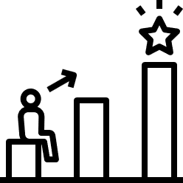

Comprehensive Planning
Step-by-Step
Draft Plan
  When do you have enough research to begin writing
    Primary concerns are addresses
    Public meetings held (statutorily required and others)
      All special board meetings are open to the public
      Planning Committee
      Public meeting within 90 days of receiving draft plan
  Monitor consultant’s progress
    Review to ensure consistency with community’s vision
4
Source: Department of State (DOS) Comprehensive Planning Website
DOS Comprehensive Planning Webinar (Step-by-Step at 53:10)
Identify Issues
Complete a SWOT Analysis for your Community.
  Strengths
  Weaknesses
  Opportunities
  Threats
1
Evaluate Alternatives
  Are goals achievable financially?
  Are there more attainable/sustainable alternatives?
  What are cost effective ways to achieve goals?
5
Community Inventory / Survey
Take a community inventory of assets within the community, not paper survey. Topics can include:
  Agriculture
  Historic / Cultural / Archeological
  Park & Recreation
  Environment
  Demographics
  Housing
  Economy
  Public Services
  Transportation
Adopt Plan
  Governing Board adopts plan by resolution or other local enactment
  Adopted plan must be considered by other governmental agencies when planning for capital projects.
6
2
Implement Plan
  Suggestions to promote concepts outlines in plan
    Amend land use regulations
    Develop design guidelines
    Budget for capital improvements
  Implementation matrix
7
Identify Goals
  Based on Identified Issues (SWOTs)
  Goals become priorities for future policy development
  Goals are measurable and achievable
  SMART Goals (Specific, Measurable, Achievable, Relevant, and Time-bound)
3
8
Evaluate Plan
  Plan must include maximum intervals for review
  Amend plan as needed

Slide 6
Comprehensive Planning
Basic Plan Outline
1. Introduction and/or executive summary
2. Existing conditions
3. Trends
4. Environmental framework
5. Development goals & policies
6. Land use constraints & opportunities
7. Land use development plan
8. Fiscal impacts
9. Implementation strategies
10. Maps
11. Appendices
Appendices can include your survey, public meeting notes and summaries, regulations, design guidelines, budgets for capital improvements, grant applications, etc.
Your Community’s Comprehensive Plan shouldn’t be something that sits on a shelf and collects dust. It should be something that your community uses and reflects on when making decisions and to move your community forward. Make your Comprehensive Plan something that you will use, it can be short and sweet, have pictures and graphs, be aesthetically pleasing, etc.
"I love it when a plan comes together." - Colonel Hannibal Smith

Slide 7
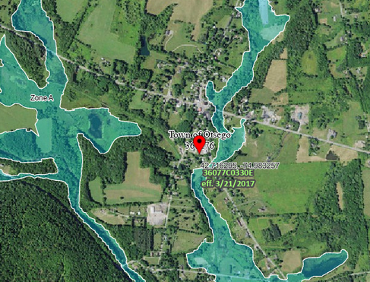
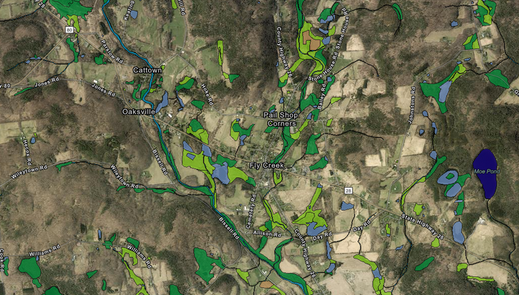
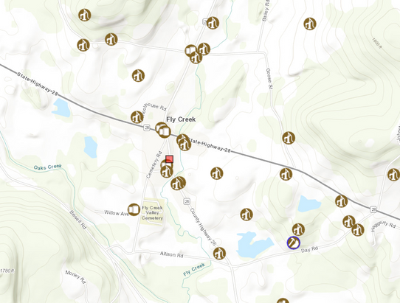
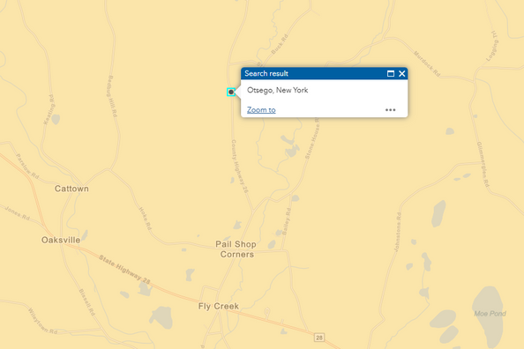
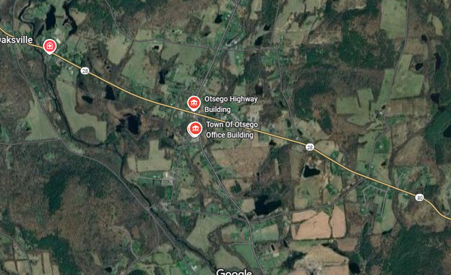
Comprehensive Planning
Community Demographics
Maps of the Community
Community Quick Facts
Population (2020): 2,756
Median households Income: $72,716
Persons under 18: 16.1%
Persons 65 and over: 22.8%
Average travel time to work: 22.8 Minutes
Homeownership rate: 71.1%
Households: 1,165
Disabled population: 15.4%
Employment Rate: 48.2%
Percent Poverty: 12.6%
Work from home: 3.3% (2023 ACS)
FEMA Flood Map
US Fish and Wildlife Wetlands
DECinfo Locator
Map Insight
The community is considered slightly distressed. There are some flood risk areas in the community. The town is mostly rural with the hamlet being more concentrated.
Census Data
Economically Distressed Areas (ESD)
Community Map

Slide 8
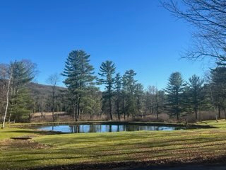
Comprehensive Planning
Importance of a Comprehensive Plan
  How your community presents itself to the outside world
  Provides clear vision and direction for your community
  Legal basis for projects within your community
  Agencies must refer to your comprehensive plan when completing projects in your community
  Assist with grant funding opportunities
  Provides framework for community development
  Protects community resources and character

Slide 9
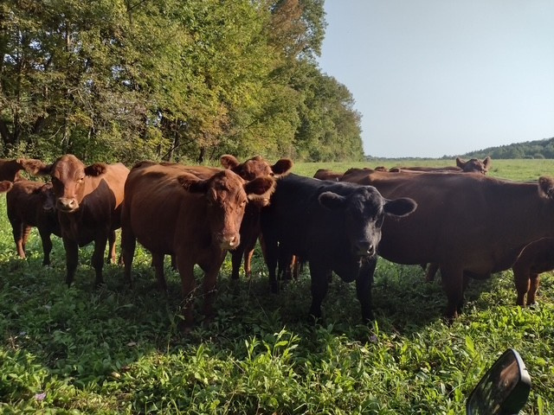
Comprehensive Planning
Importance of a Community Input
  Grounds the plan in reality and speaks to what your community wants for the future
  Identifies your communities priorities and needs
  Ensures that the plan is developed with the whole community in mind
  Creates a trusting, transparent, and engaging partnership
  Creates realistic goals and strategies for your community
  Provides input for potential grant funding opportunities
  Creates a more useable and beneficial comprehensive plan

Slide 10
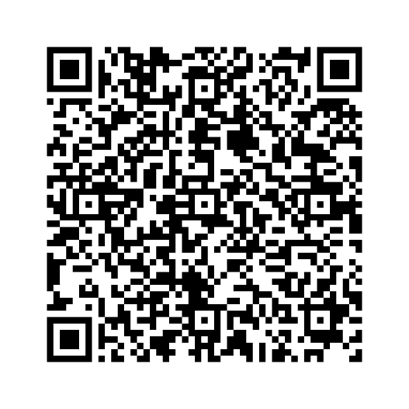

What can you do?
Link to Survey
  Complete a survey
  join a subcommittee
  share the survey with your friends, family, and neighbors
  attend community meetings

Slide 11
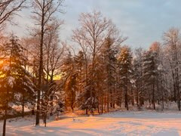
Community Vision
From 2008 Comprehensive Plan
We, the Town of Otsego citizens, cherish and protect our rural and natural landscape. We assure that plentiful, accessible open spaces continue to exist. We see agriculture as a continuing important part of the Town's economy and character. We respect our traditions and history, and so preserve the Town's historic architecture and character. We wish to encourage new development to honor the ways our hamlets have looked through their long histories. Hence we promote careful design and placing of new buildings to complement and harmonize with those already here. We Town citizens are committed to involvement in its future and are proud of our strong community identity.

Slide 12
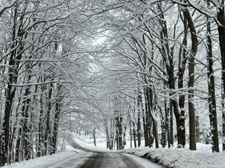
Community Vision
From 2008 Comprehensive Plan
We foresee the future Town of Otsego as continuing to have a clean environment, beautiful landscape, a rural character. We foresee carefully managed growth and development, maintaining accessto our natural areas. We foresee a place of safety for us and our families.
We expect increased year-round recreational and cultural opportunities, including biking,hiking, and walking trails, and ample access to Otsego and Canadarago Lakes. We see residents and visitors here enjoying even more accessto the arts and cultural events.

Slide 13
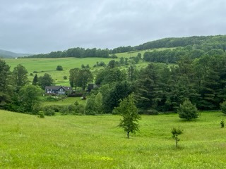
Community Vision
From 2008 Comprehensive Plan
We want added economic growth, with more diverse year-round businesses that serve both residents and visitors. We want low-impact, family-owned small businesses to flourish, not onlyin Cooperstown, but in Fly Creek, the Town's secondary center for retail and service operations. We want the Town of Otsegoto develop housing and jobs to draw young families here.

Slide 14
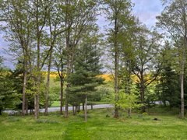
Community Vision
From 2008 Comprehensive Plan
We foresee high quality and diverse housing for all income levels and ages, with special attention given to housing our elderly so that they can continue life right here. We want residential development, concentrated in and around the hamlets, to strengthen our neighborhood, economy, and sense of community. We foresee hamlet amenities like sidewalks and street trees adding to its desirability as a place to live. Beyond the hamlets, we foresee a mix of current size and some smaller, affordable homes surrounded by open land and farms. We foresee all homes and neighborhoods safe andwell maintained.

Slide 15
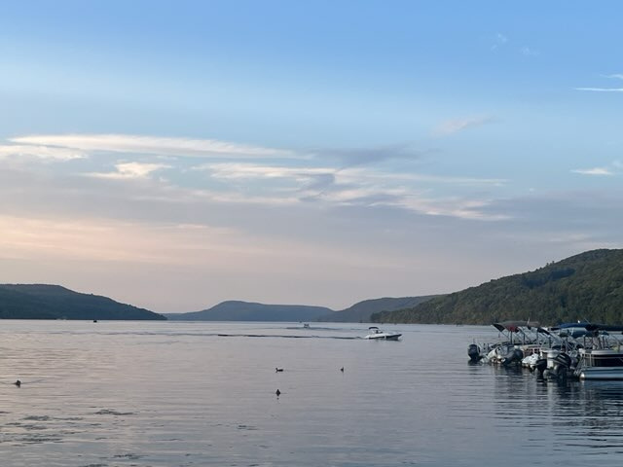
Community Vision
From 2008 Comprehensive Plan
We want roads well-built, maintained, and reflective of our rural and historic heritage. We want traffic volume and speed controlled to harmonize with the Town as a place of homes.
We foresee high-quality schools for our youngsters and a Town government that works to provide both public services and reasonable taxes. We foresee the Town working even
more cooperatively with the Towns and Villages in the Leatherstocking region, promoting their good and ours.
This is our vision, the touchstone for our shared future.

